Slide 1
CSE Presentation Project Viamigo

Slide 2
Overview
Introduction
Project scope
Challenges
Techniques
Project result
Questions

Slide 3
Viamigo
Current project
Follow-up project

Slide 4
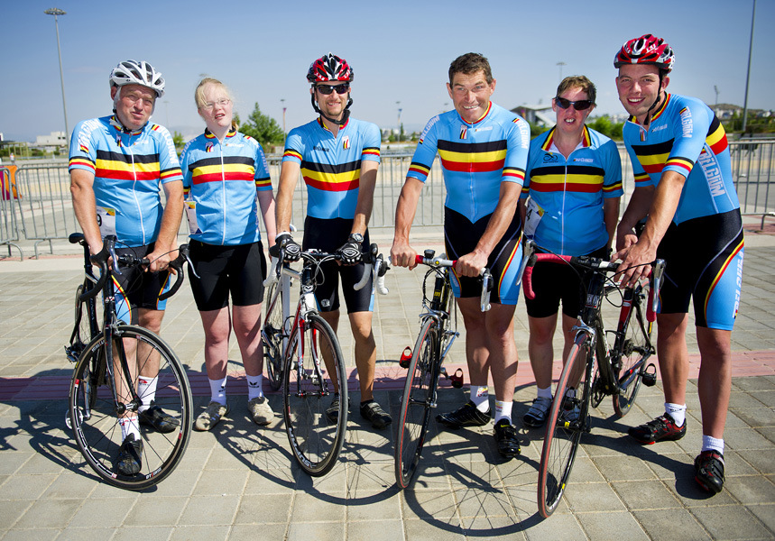
Viamigo: client = person with idd
www.special-olympics.be

Slide 5
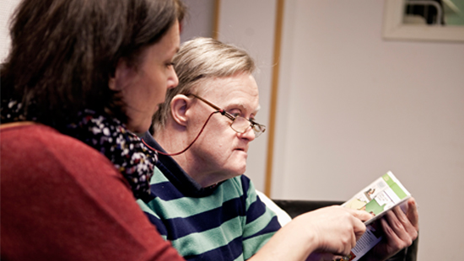
Viamigo: coach = caretaker
phpcares.org

Slide 6
Viamigo
Current project
Follow-up project

Slide 7
Project scope
Communication between the coach and the client
one-way (coach → client, system → coach,..)
two-way (coach → client → coach,…)
Simulate the use of the app in 'real life' situations
Interact with clients for design suggestions
Compatible with Viamigo app.

Slide 8
Project challenges
International project
Combination work and study
Interaction with clients

Slide 9
International project
Problems
Language
Project content

Slide 10
International project
Solutions
Project expansion
app_for_communication_between_coach_and_user.docx
app_for_communication_between_coach_and_user_expansion_1.docx

Slide 11
Combination work and study
Project progress

Slide 12
Combination work and study
Solutions
Recorded sessions
on-line meetings
Reports of meetings
Notebook

Slide 13
Interaction with end-user
www.bestbuddies.org

Slide 14
Techniques
User Centred Design

Slide 15
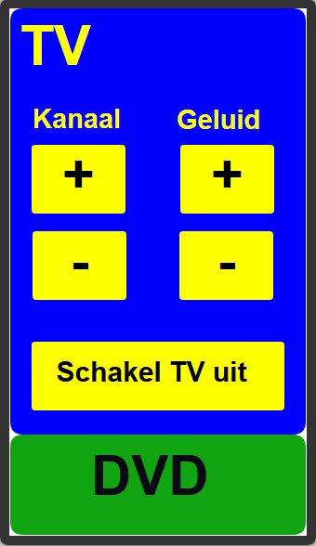
User Centred Design

Slide 16
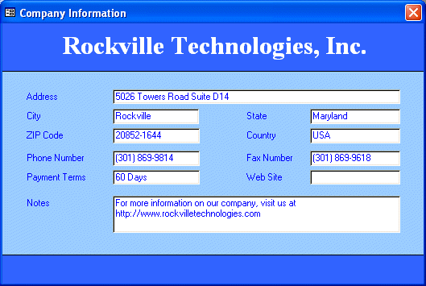
User Centred Design
www.yevol.com

Slide 17
User Centred Design
Appreciative inquiry
Maguire framework

Slide 18
Maguire framework
Planning | Context of use | Requirements | Design | Evaluation
Excel document | 4.1 Identify Stakeholders | 5.1 Stakeholder analysis | 6.1 Brainstorming | 7.2 Assisted evaluation
 | 4.2 Context of use analysis | 5.5 Scenarios of use | 6.2 Parallel design | 7.3 Heuristic or expert evaluation
 | 4.4 Field study/user observation | 5.7 Existing system analysis | 6.8 Software prototyping | 7.4 Controlled user testing
 | 4.5 Diary keeping | 5.10 User, usability and organizational requirements | 6.9 Wizard-of-Oz prototyping

Slide 19
Scenarios for communication with clients
communicatie_vpadv2.docx
scenario_20150513.docx

Slide 20
Scenario 3
Client leaves on foot but gets lost.
System sends message to client: Stop! Verkeerde weg!
System sends message to coach: Cliënt is verloren gelopen
Coach sends message to client:
Ik kom eraan
Vraag iemand om hulp. Toon je kaart
Bel me op.

Slide 21
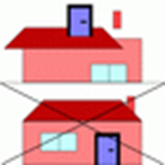
Pictogram translation: Stop! Verkeerde weg!
Verkeerde

Slide 22
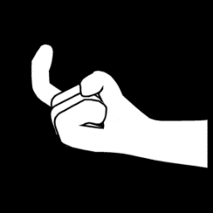
Pictogram translation: Ik kom naar jou
naar

Slide 23
Pictogram translation: Vraag hulp aan iemand. Toon je kaart
iemand
Toon

Slide 24
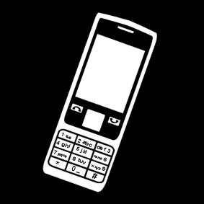
Pictogram translation: Bel me

Slide 25
Pictogram translation v2: Stop! Verkeerde weg!

Slide 26
Pictogram translation v2: Ik kom naar jou

Slide 27
Pictogram translation v2: Vraag hulp aan iemand. Toon je kaart

Slide 28
Pictogram translation v2: Bel me

Slide 29
Developing app for role play
Viamigo app
Demo app

Slide 30
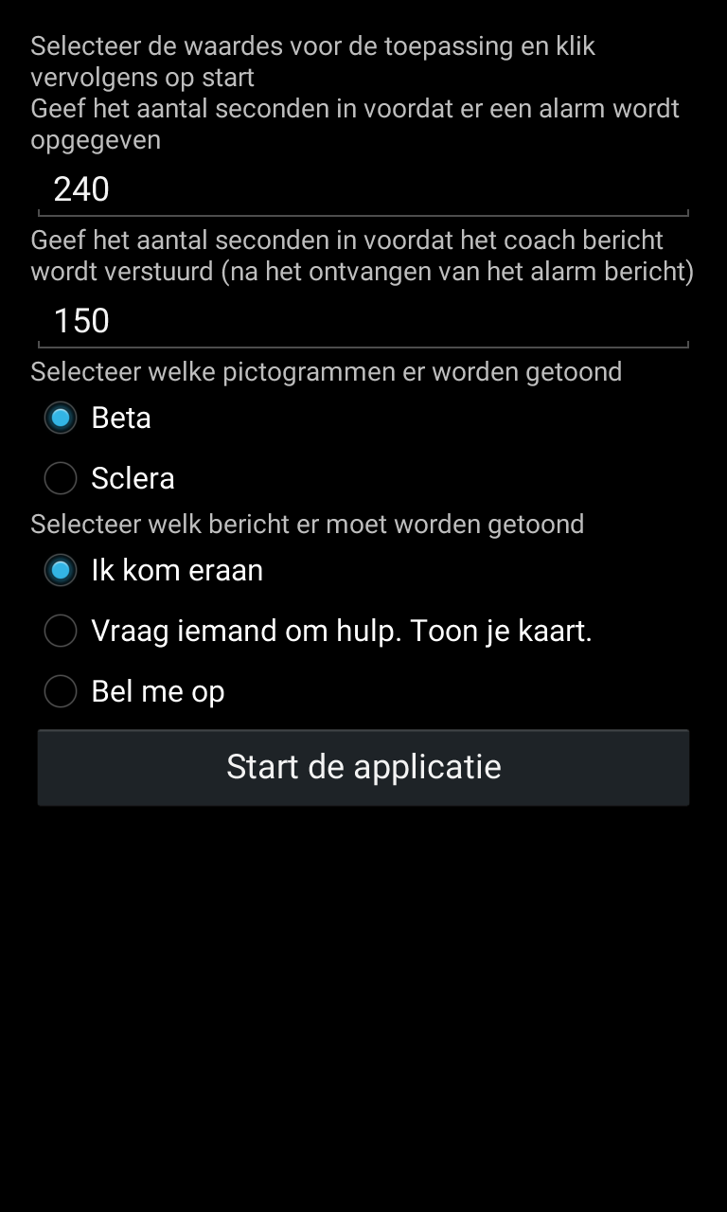
User interface

Slide 31
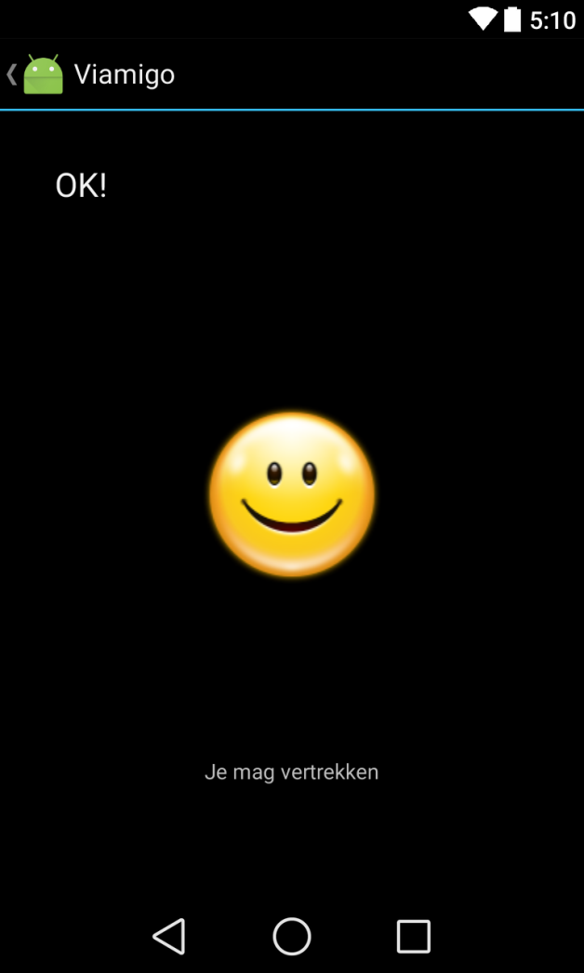
User interface

Slide 32
Test of user interface
Client N
Client V
Client P

Slide 33
Results of user test
Protected environment
Repetition
Sound
One clear message

Slide 34
Future of the follow-up project
Meeting with parents
Testing other scenarios
Integrated in Viamigo app

Slide 35
CSE Course

Slide 36
Questions?
contact:
danny_wouters9@hotmail.com

